Slide 1
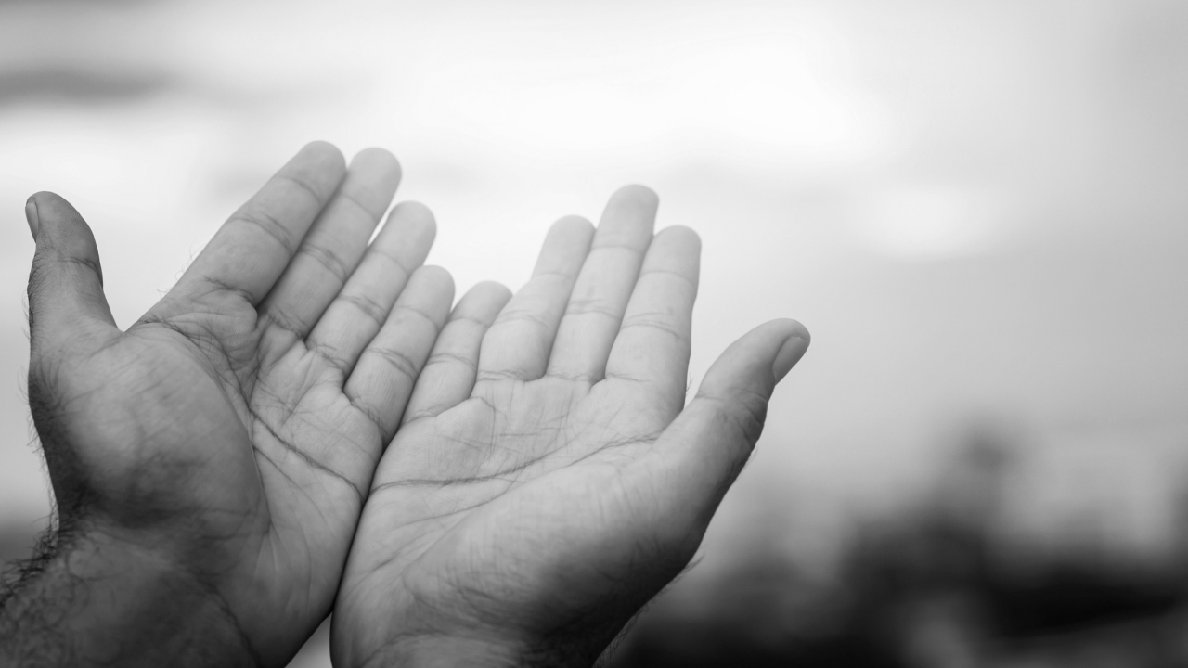

Racial Justice
Prayer & Action
Challenge
Week 1:
Lament

Slide 2
Litany of Lamentation: How Long?
One: Christ, You share our poverty. You dwell with us in our food deserts. Every day you know it seems the same, the struggle for life never ceasing.
All: How long do we have to wait to enter your promised land?

Slide 3
Litany of Lamentation: How Long?
One: Jesus, You hear the lies told about us. We are not lazy. We do not waste anything you have given us. Every day you join us as we struggle to pay our bills
All: How long do we have to wait to enter your promised land?

Slide 4
Litany of Lamentation: How Long?
One: Savior, You know that we are being cheated out of our wages. We work hard. We are essential workers. Every day we pray for your strength to struggle through each and every day.
All: How long do we have to wait to enter your promised land?

Slide 5
Litany of Lamentation: How Long?
One: Human One, You know how it is to live rough on the streets with no place to lay your head. The rent is too high. We have no place to go. Every day you join us as we seek a place to shelter.
All: How long do we have to wait to enter your promised land?

Slide 6
Litany of Lamentation: How Long?
One: Holy One, You have faith in us and we trust in you. You never leave our side. You are always there to give us encouragement and support. Every day you join with us and hope for a better day.
All: No matter how long the journey takes, we know that together we shall enter into your promised land. May it be today. Amen.

Slide 7
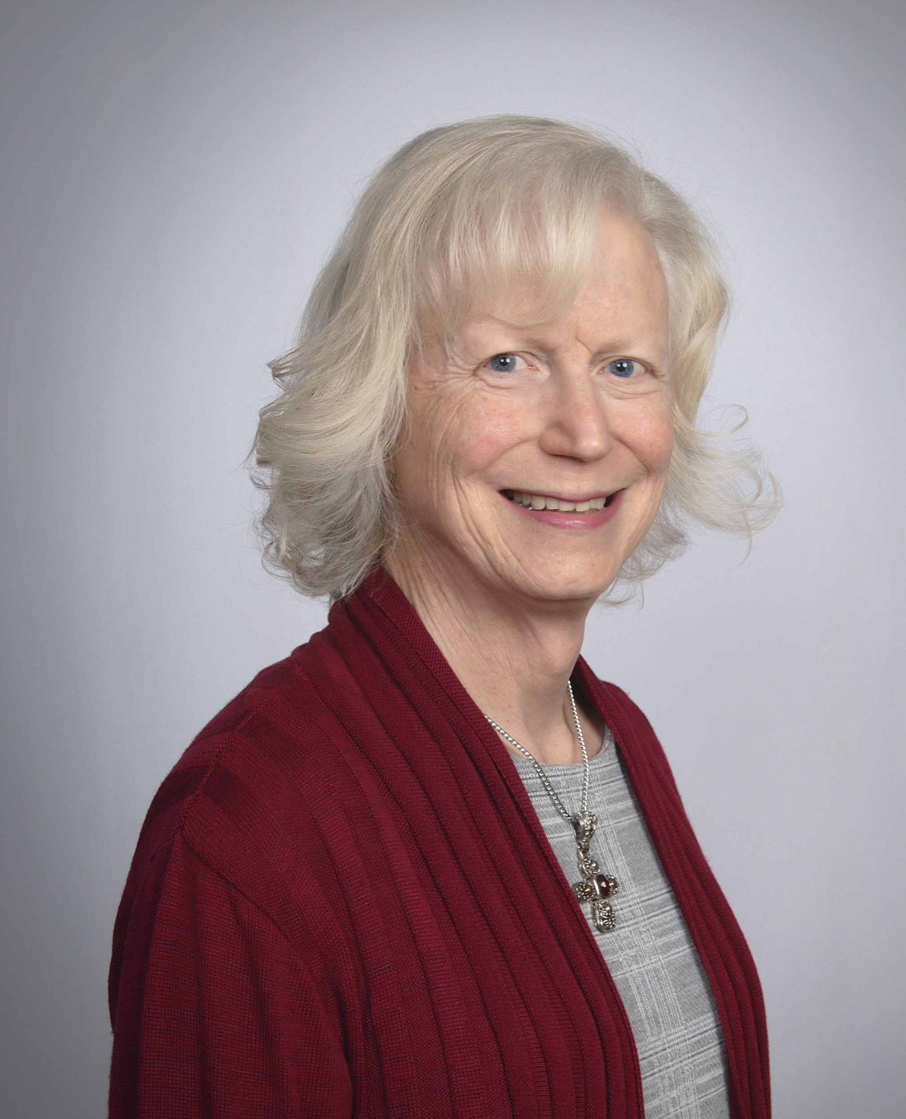

Litany Composed by Rev. Mary C. Johnson.
Rev. Mary C. Johnson is a retired member of the Baltimore-Washington Conference. She earned an MDiv from Asbury Theological Seminary and a Graduate Certificate in Spiritual Direction from Moravian Theological Seminary. She is a member of the Upper Room’s Academy for Spiritual Formation. She has served Congregations in Indiana, Maryland, Delaware, and Pennsylvania.
She now resides in Carrollton, Virginia.

Slide 8
Racial Justice
Prayer & Action
Challenge
Week 2:
Repentance

Slide 9
Litany of Repentance: We Are Unclean
One: Out of our mouths we spew unclean words: racist words, sexist words, misogynist words, homophobic words, ableist words. Our words tear down, undermine, and shame. Our words are cruel. They are our false witness.
All: These are the words we have offered to you. Please forgive us.

Slide 10
Litany of Repentance: We Are Unclean
One: We have behaved in unclean ways: prejudicial, discriminatory, xenophobic ways. Our actions have harmed the lives of others, polluted their air and water, and taken food out of the mouths of their children. Our actions are unthoughtful. They are our false testimony.
All: These are the actions we have offered to you. Please forgive us.

Slide 11
Litany of Repentance: We Are Unclean
One: Make us mindful of our words. We want to become your voice for the voiceless. We want to sound clearly your cry for justice and mercy. We want to speak your words of grace and peace.
All: These are the words we desire to offer you. Please hear our cry and may it be so.

Slide 12
Litany of Repentance: We Are Unclean
One: Make us mindful of how we act. We want to stand with those who now stand alone. We want to give a hand to those who have been pushed down. We want you to use us to wipe tears from eyes and to give support to those who feel they cannot go on.
All: These are the actions we desire to offer to you. Please hear our cry, and may it be so.

Slide 13
Litany Composed by Rev. Mary C. Johnson.
Rev. Mary C. Johnson is a retired member of the Baltimore-Washington Conference. She earned an MDiv from Asbury Theological Seminary and a Graduate Certificate in Spiritual Direction from Moravian Theological Seminary. She is a member of the Upper Room’s Academy for Spiritual Formation. She has served Congregations in Indiana, Maryland, Delaware, and Pennsylvania.
She now resides in Carrollton, Virginia.

Slide 14
Racial Justice
Prayer & Action
Challenge
Week 3:
Healing

Slide 15
Litany of Healing: Giving Birth
One: We have felt the pain. We have felt the world contract. We have felt the urgent need to push into the future. We know that God is in the process of creating all things new.
All: Letting go of the pains of our past, we embrace with love all that God is doing next.

Slide 16
Litany of Healing: Giving Birth
One: Out of the blood and the sweat, we are given the gift of new life, a new day, a new beginning. The past is a memory, but the future reaches out into our dreams.
All: Letting go of the pains of our past, we embrace with love all that God is doing next.

Slide 17
Litany of Healing: Giving Birth
One: Shaped by the lessons of the past, we sing a new lullaby to calm the fears of all that is new: a new chance to love, where there was hate; a new chance to create, where there was only desolation.
All: Letting go of the pains of our past, we embrace with love all that God is doing next.

Slide 18
Litany of Healing: Giving Birth
One: Sharing the strength God has given us, we allow new life to drink deeply of the goodness that fills our breasts. Rebuilding new life in God’s own image: building dignity, pride, and self-respect. We are holding the future securely in our arms.
All: Letting go of the pains of our past, we embrace with love all that God is doing next.

Slide 19
Litany Composed by Rev. Mary C. Johnson.
Rev. Mary C. Johnson is a retired member of the Baltimore-Washington Conference. She earned an MDiv from Asbury Theological Seminary and a Graduate Certificate in Spiritual Direction from Moravian Theological Seminary. She is a member of the Upper Room’s Academy for Spiritual Formation. She has served Congregations in Indiana, Maryland, Delaware, and Pennsylvania.
She now resides in Carrollton, Virginia.

Slide 20
Racial Justice
Prayer & Action
Challenge
Week 4:
Reconciliation

Slide 21
Litany of Reconciliation: Godly Eyes
One: We desire Godly eyes. We want to see others as Christ sees them. We want to see others as beloved. We need to see their struggles. We need to see their pain. We need to see their heart.
All: We want to stand amazed as we look upon Love’s new creation.

Slide 22
Litany of Reconciliation: Godly Eyes
One: We desire Godly eyes. We need to observe the new creation. We need to see that others have a new heart beating. We need to recognize the reprogramming of their minds. We desire to share in God’s joy.
All: We want to stand amazed as we look upon Love’s new creation.

Slide 23
Litany of Reconciliation: Godly Eyes
One: We want Godly eyes. We need a view of new life’s becoming. We need to see God’s reasons for hope. We need to notice like God does, even minute changes in the lives of others, so that I might encourage even the smallest spark of new life.
All: We want to stand amazed as we look upon Love’s new creation.

Slide 24
Litany of Reconciliation: Godly Eyes
One: We want Godly eyes. We need to see the old passing away. We need to notice the renewal of minds. We do not want to miss the hard-won changes, opening hearts to a deeper compassion. We need a chance to sing and dance our hallelujahs.
All: We want to stand amazed as we look upon Love’s new creation.

Slide 25
Litany Composed by Rev. Mary C. Johnson.
Rev. Mary C. Johnson is a retired member of the Baltimore-Washington Conference. She earned an MDiv from Asbury Theological Seminary and a Graduate Certificate in Spiritual Direction from Moravian Theological Seminary. She is a member of the Upper Room’s Academy for Spiritual Formation. She has served Congregations in Indiana, Maryland, Delaware, and Pennsylvania.
She now resides in Carrollton, Virginia.

Slide 26
Racial Justice
Prayer & Action
Challenge
Week 5:
Hope

Slide 27
Litany of Hope: We Will Grow Again
One: We were stripped of our language and culture. We were deprived of the rituals and dances that fed out souls. They silenced our drums and our songs.
All: We will grow again. Hear us speak. See us dance to the sound of our own rhythms.

Slide 28
Litany of Hope: We Will Grow Again
One: They stole our land. They cheated us out of forty acres and a mule. They made promises they never kept and laws we have had to break.
All: We will grow again. See our resilience. Behold our pride in all we have accomplished.

Slide 29
Litany of Hope: We Will Grow Again
One: They tried to silence out history. Others may have forgotten, but we never will. The truth will drown out their lies. Our lives are beautiful. Our ways are brilliant.
All: We will grow again. Listen to our stories of sacrifices long remembered. Know the source of our pride, the reason for our vision.

Slide 30
Litany of Hope: We Will Grow Again
One: We are more than our past. The past is but the seeds of our future. A whole future that others never dreamed for us is before us, the gift of God.
All: We will grow again. We have not come to the end of our journey. Behold, God is still creating through our sacred lives. God is now ready to do something extravagant.

Slide 31
Litany Composed by Rev. Mary C. Johnson.
Rev. Mary C. Johnson is a retired member of the Baltimore-Washington Conference. She earned an MDiv from Asbury Theological Seminary and a Graduate Certificate in Spiritual Direction from Moravian Theological Seminary. She is a member of the Upper Room’s Academy for Spiritual Formation. She has served Congregations in Indiana, Maryland, Delaware, and Pennsylvania.
She now resides in Carrollton, Virginia.

Slide 32
Racial Justice
Prayer & Action
Challenge
Week 6:
Liberation

Slide 33
Litany of Liberation: Anointed
One: Love hears the voice of poverty: every cry for food, the softest whimper from the cold by those seeking shelter, the deep sighs of those longing to wear more than rags.
All: The Spirit of Love anoints us to be good news and change the world.

Slide 34
Litany of Liberation: Anointed
One: Mercy hears the voice of injustice: cries for freedom, the anguish of trauma, the prayers of repentance, the agony of addiction.
All: The Spirit of Mercy anoints us to work to set prisoners free.

Slide 35
Litany of Liberation: Anointed
One: Compassion hears those shouting in darkness: cries from frustration, from a lack of understanding, songs seeking to chase away the shadows, tears that dim visions of a future.
All: The Spirit of Compassion anoints us to open the eyes of the blind.

Slide 36
Litany of Liberation: Anointed
One: Grace hears the pain of the oppressed: the pain of racism, the pain of colonialism, the pain of sexism, the pain of homophobia, the pain of ableism.
All: The Spirit of Grace anoints us to free all who are oppressed.

Slide 37
Litany of Liberation: Anointed
One: Joy listens for our celebration: shouts of triumph over evil, cheers for those who have persevered. The songs of delight as we let freedom ring.
All: The Spirit of Joy anoints us to proclaim divine favor to us all.

Slide 38
Litany Composed by Rev. Mary C. Johnson.
Rev. Mary C. Johnson is a retired member of the Baltimore-Washington Conference. She earned an MDiv from Asbury Theological Seminary and a Graduate Certificate in Spiritual Direction from Moravian Theological Seminary. She is a member of the Upper Room’s Academy for Spiritual Formation. She has served Congregations in Indiana, Maryland, Delaware, and Pennsylvania.
She now resides in Carrollton, Virginia.

